Slide 1

Stock Trends Prediction
Deep Learning Project in Python with Web App by using Streamlit
Project by
Hassan Ahmed Khan

Slide 2
Abstract:
This stock prediction system aims to forecast the future prices of stocks by analyzing historical data and market trends. The system utilizes deep learning algorithms to identify patterns and relationships within data sets to make accurate predictions. It incorporates various features such as stocks info (i.e. Opening & Closing Price of current date, Institutional holders, balance sheet, Cash Flow etc.) and news headlines to provide a comprehensive analysis of the stock's performance. The system also offers visualization tools to help users better understand the data and make informed investment decisions. The system's performance is evaluated based on metrics such as accuracy, MAE, MSE ensuring its reliability and effectiveness. Overall, this stock prediction system offers investors a powerful web app to make informed decisions based on data-driven insights.

Slide 3
SCOPE OF THE PROJECT:
The scope of this project is to develop a web app that can predict the future stock prices of selected companies using machine learning techniques. The app will allow users to enter a company's ticker symbol and retrieve its historical data from a reliable data source such as Yahoo Finance. The data will be preprocessed, analyzed, and used to train a deep learning model. The trained model will then be used to make future stock price predictions. The app will display the predicted prices along with a graphical representation of the predicted trends.

Slide 4
Python Libraries:
alpha_vantage==2.3.1
cufflinks==0.17.3
gnews==0.2.7
matplotlib==3.3.2
numpy==1.24.2
pandas==1.5.2
pandas_datareader==0.10.0
prophet==1.1.2
pyrebase==3.0.27
requests==2.28.1
scikit_learn==1.2.2
seaborn==0.11.0
statsmodels==0.12.0
streamlit==1.16.0
streamlit_lottie==0.0.3
streamlit_option_menu==0.3.2
tensorflow==2.11.0
tensorflow_intel==2.11.0
yfinance==0.2.3
Numpy==1.24.1

Slide 5
Front-end & Back-end Technologies:
Front-end Technologies | Back-end Technologies
Streamlit | Python
HTML | Firebase (Database)
CSS | Numpy (Python)
Lottie_Files | Pandas (Python)
Adobe Illustrator | Scikit-learn (Python)
Matplotlib & Seaborn | CNN-LSTM, TensorFlow (Python)

Slide 6
Technologies USed:
CNN-LSTM
In a CNN-LSTM model, the CNN layers are typically used to extract features from each frame or time step of the input sequence, and the LSTM layers are used to model the temporal dependencies between the frames. The output of the LSTM layers can then be fed into one or more fully connected layers for classification or regression tasks.
FbProphet
Prophet is a time-series forecasting algorithm developed by Facebook. It is designed to be flexible, scalable, and easy to use, making it a popular choice for business forecasting applications.
Tensorflow
TensorFlow is an open-source software library for dataflow and differentiable programming across a range of tasks, including machine learning (ML), deep learning (DL), and neural networks (NN).

Slide 7
Min Hardware Requirement:
Processor: At least a quad-core processor or higher, with a clock speed of 2 GHz or faster. This will help with processing the data and running the prediction model efficiently.
RAM: At least 8 GB of RAM is recommended to handle the data and to run the prediction model effectively. However, the more RAM available, the better the performance.
Storage: Sufficient storage capacity is required to store historical data and trained models. A minimum of 100 GB of storage capacity is recommended.
Graphics Processing Unit (GPU): If the model uses deep learning algorithms such as CNN or LSTM, then a dedicated GPU with CUDA cores is recommended. A GPU can significantly speed up the training process.
Network Connectivity: The web app should have a reliable and fast internet connection to fetch the latest stock data from Yahoo Finance and to deliver the predictions to the user interface.

Slide 8
Phases of Stock prediction model
Data Collection
Data Pre-processing
Data Analysis
Machine Learning, Deep Learning
Feature Engineering
Results Presentation
To get the data from Yahoo Finance I used the yfinance library, as it is reliable and widely used financial data source. Yahoo Finance provides historical and real-time data for stocks, currencies, commodities, and other financial instruments.

Slide 9
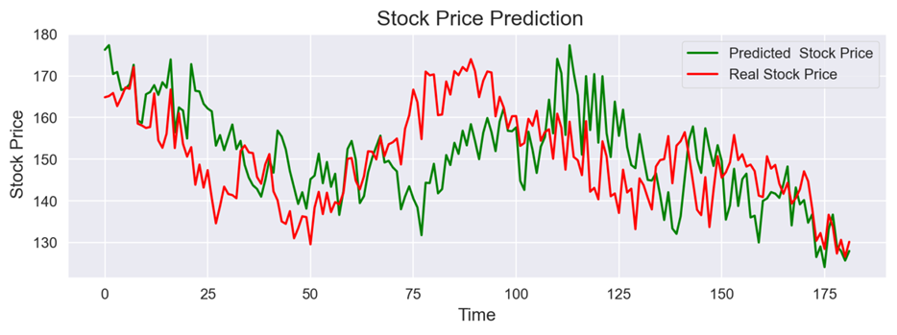
Web Application Framework for Stock Trend Prediction by using Streamlit
Raw Data
Data Cleaning
Model Training
Prediction Analysis
Prediction
Prediction of APPLE Stock Prices

Slide 10
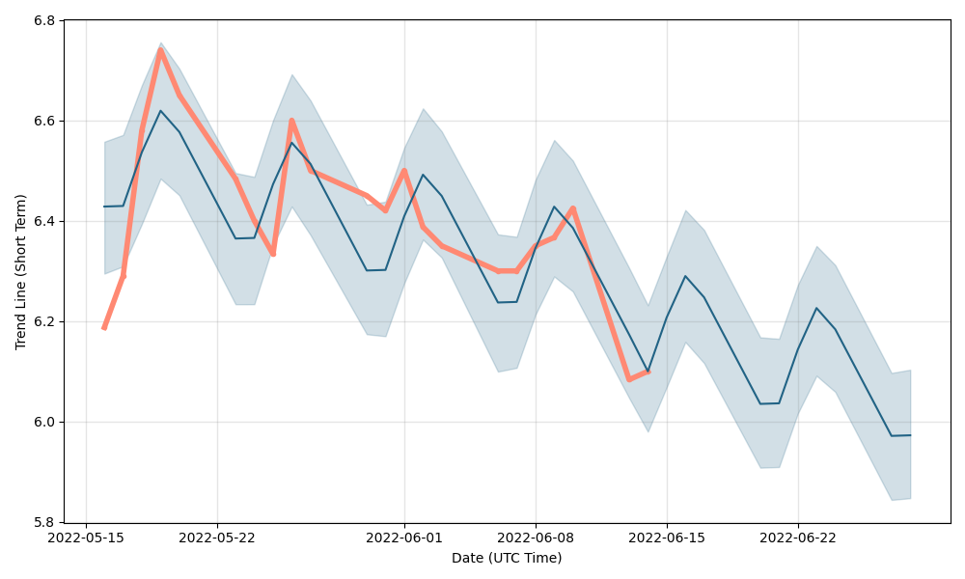
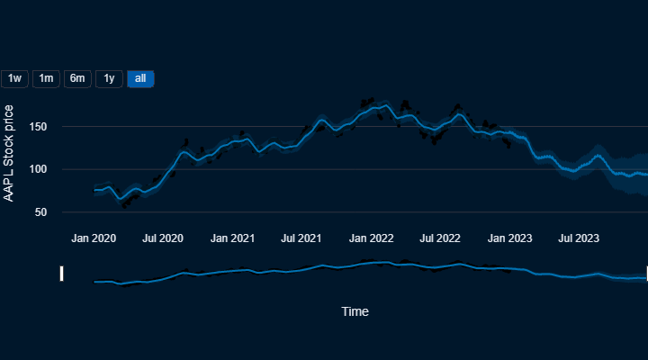
Short-term vs. long-term Analysis
VS
EDA Stock Chart and Share Price Forecast, Short-Term "EDA"
EDA Forecast Chart, Long-Term Predictions for
Next Months and Year: 2020, 2021, 2023
Stock Prediction for Next Days and Weeks

Slide 11
Thank You
For Your Attention

